Slide 1
Investigating the Economic Health of the United Nations
Peter Ilhardt
November 5, 2019

Slide 2
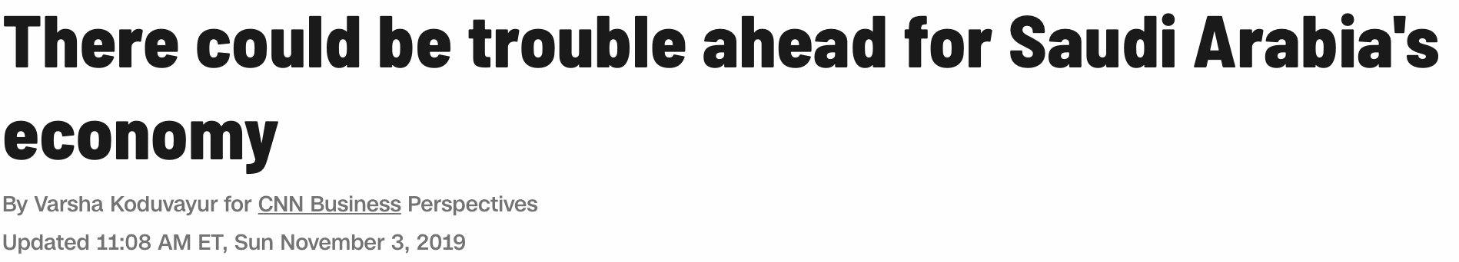



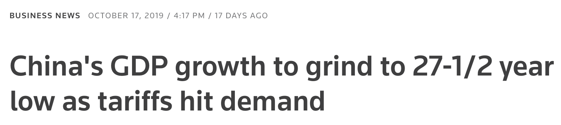



Article 1 of the UN Charter: “To achieve international co-operation in solving international problems of an economic, social, cultural, or humanitarian character...”

Slide 3
What Factors Most Influence a Nation’s Wealth?
Sources: United Nations Statistics Division (UNdata), Wikipedia
Data: Economic and social aggregate metrics for 182 nations as measured in 2005, 2010, and 2015
Aim: Predict GDP per capita in 2015 and determine most predictive metrics

Slide 4
Modeling Workflow
Load and Clean Data
Web scraping and querying
Exploratory Data Analysis
Univariate and bivariate relationships
Principal components analysis
Build Models
Multiple linear regression
Cross-validation
Optimize Models
Regularization
Evaluate and Interpret
Evaluate model fit and predictions
Feature selection
Interpret significant features
Normalization, transformation
Sparse features and imputation
Decision trees and random forests
Parameter tuning

Slide 5
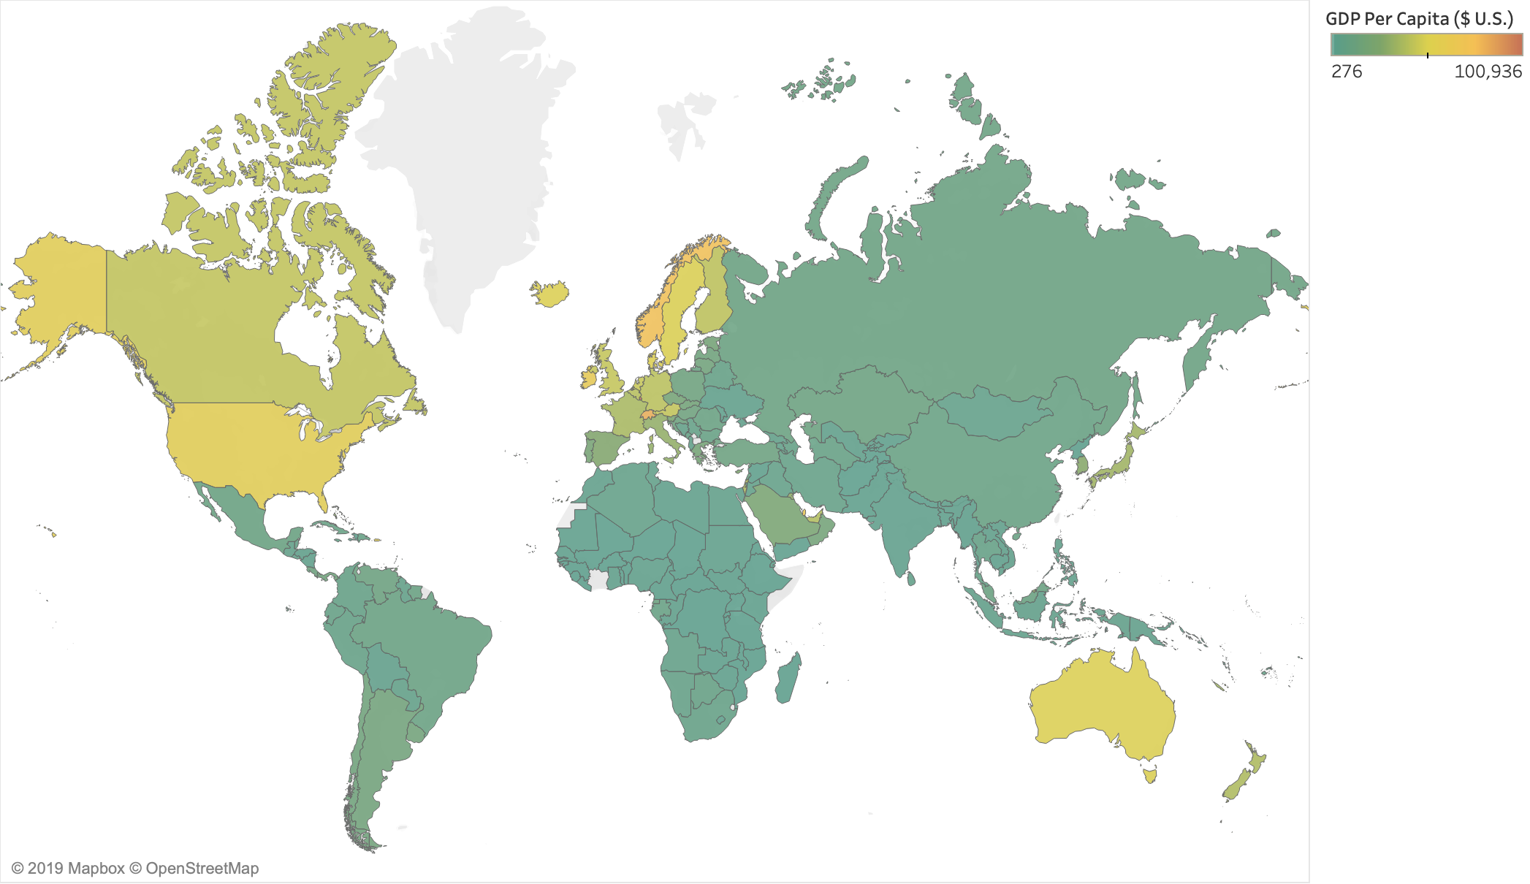

Slide 6
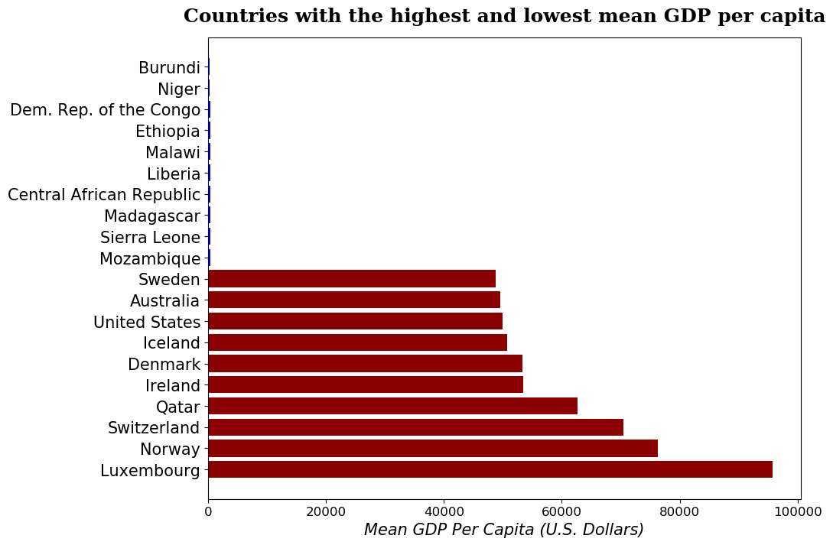

Slide 7
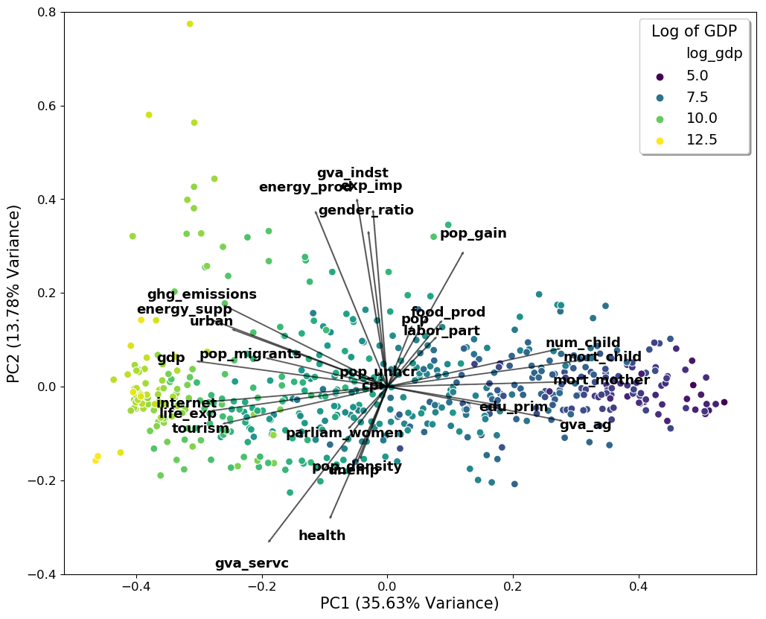
PCA
Qatar
Reduces dimensions by generating new features that capture variance
Allows us to “project” the data to a lower-dimensional space to visualize sample-feature relationships
GDP appears correlated with features such as life expectancy and urbanization

Slide 8
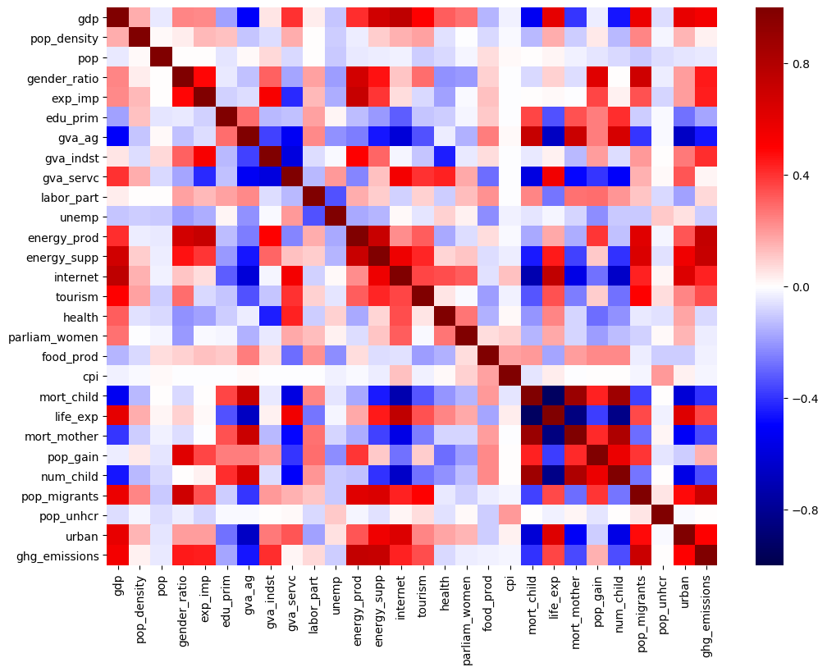
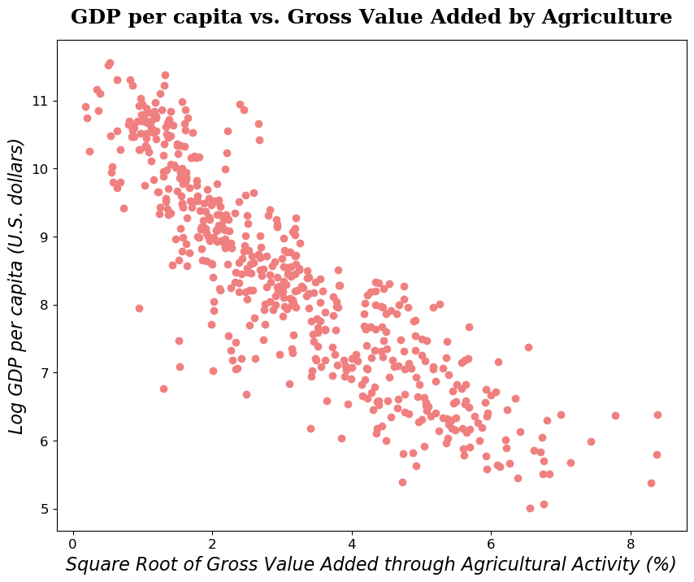
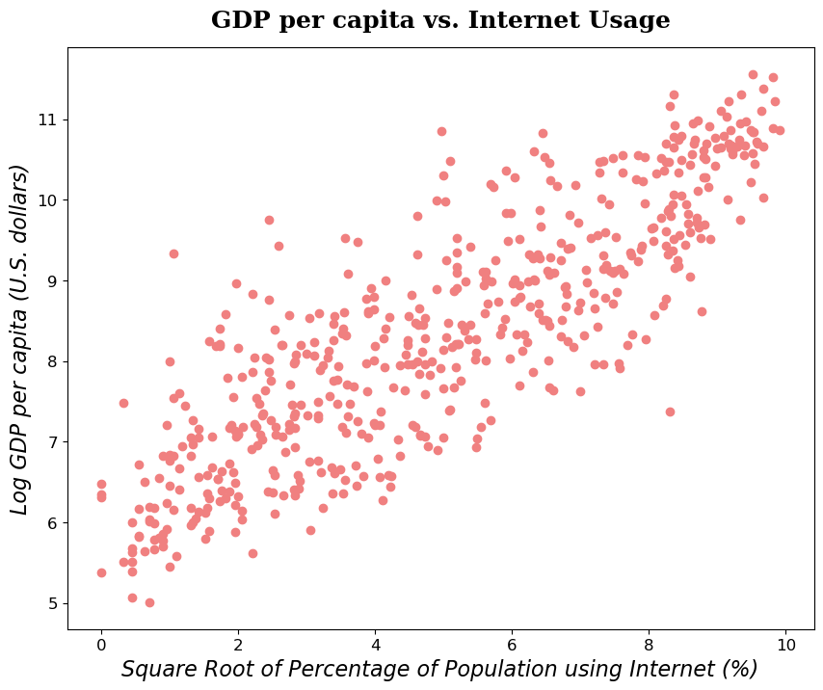

Slide 9
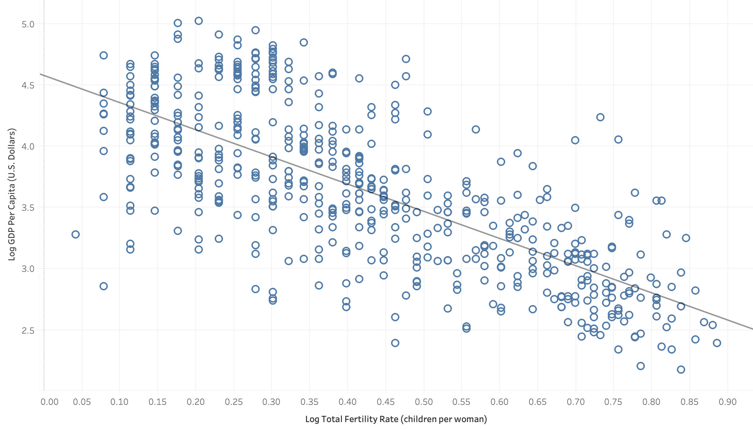
Confounding Variables

Slide 10
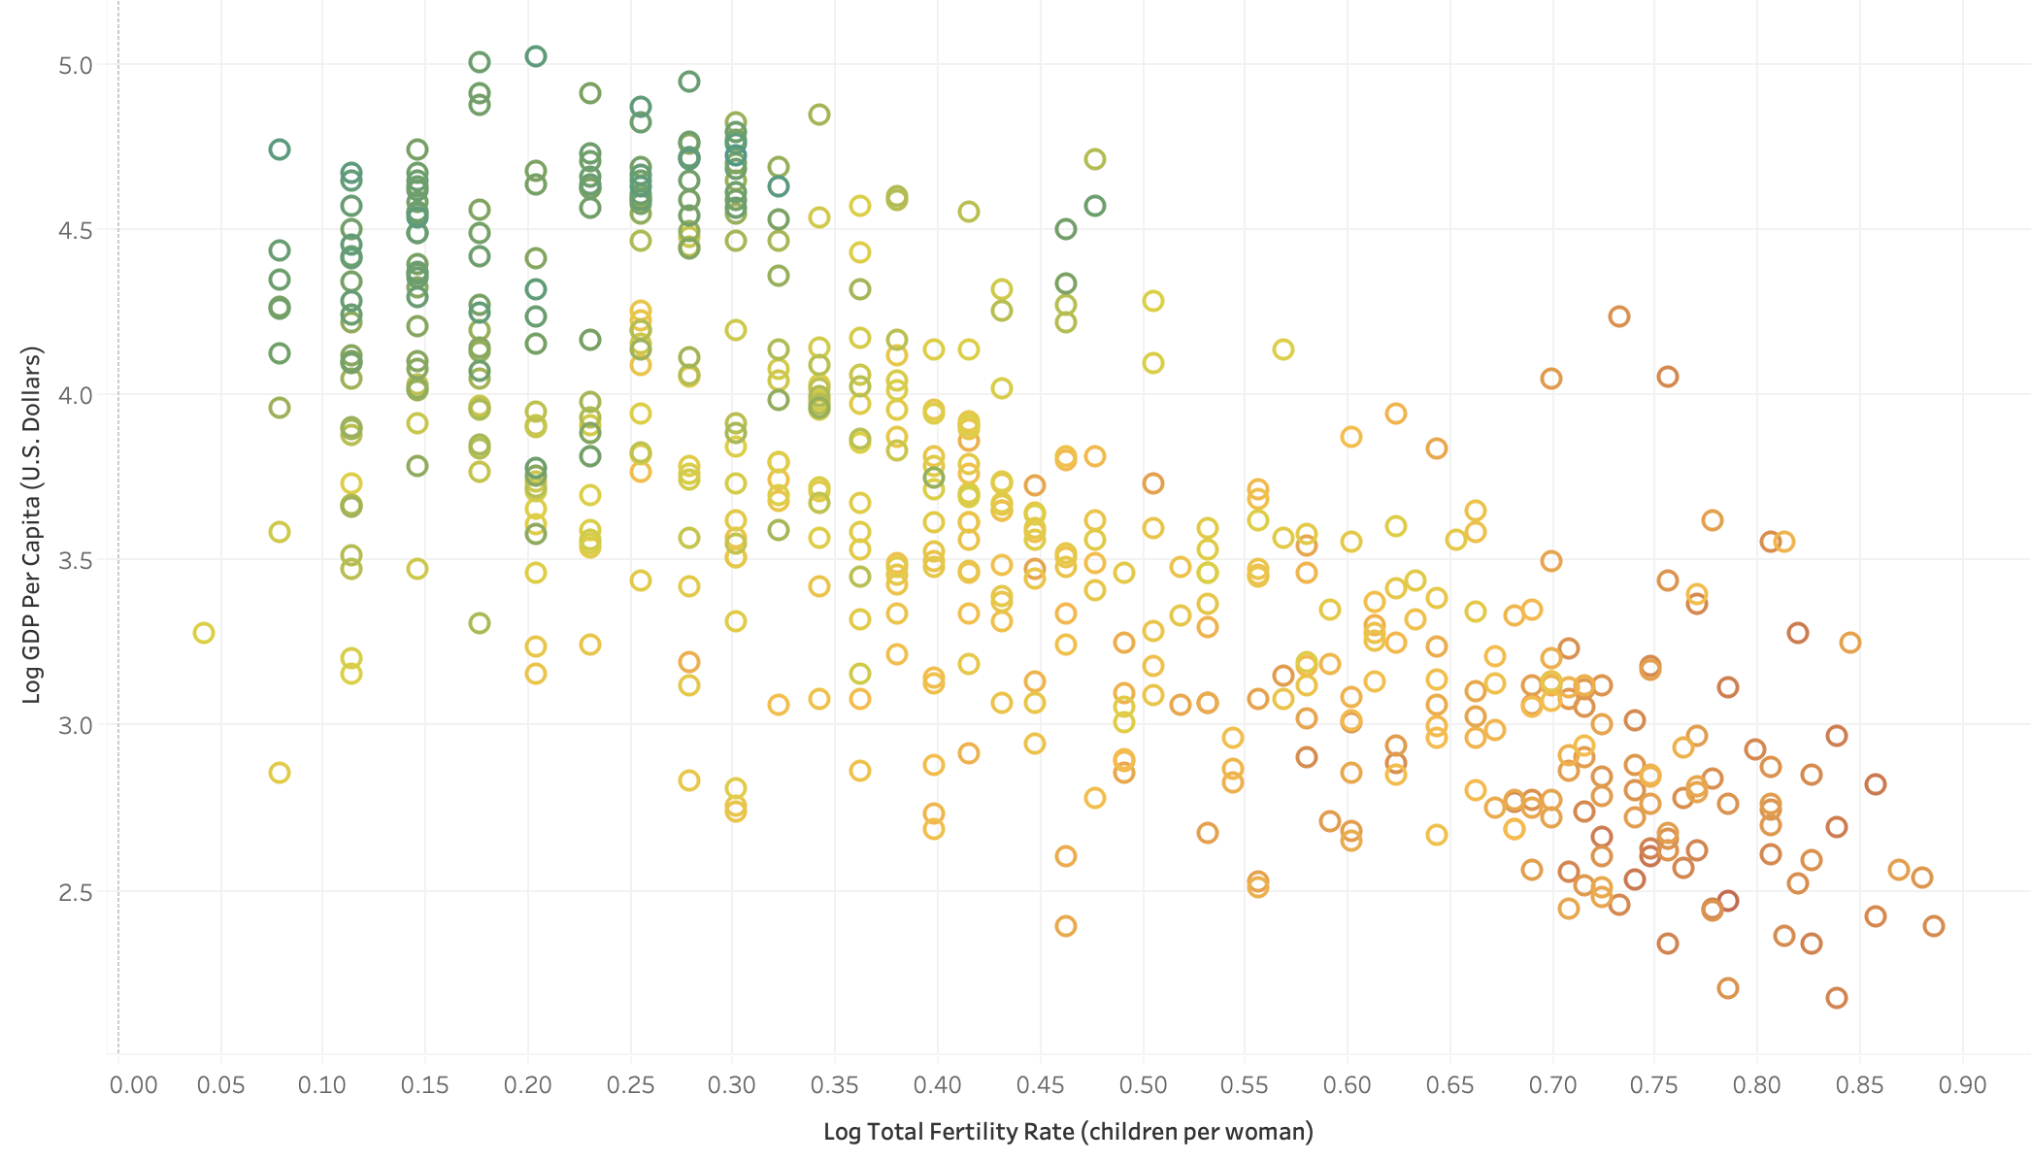
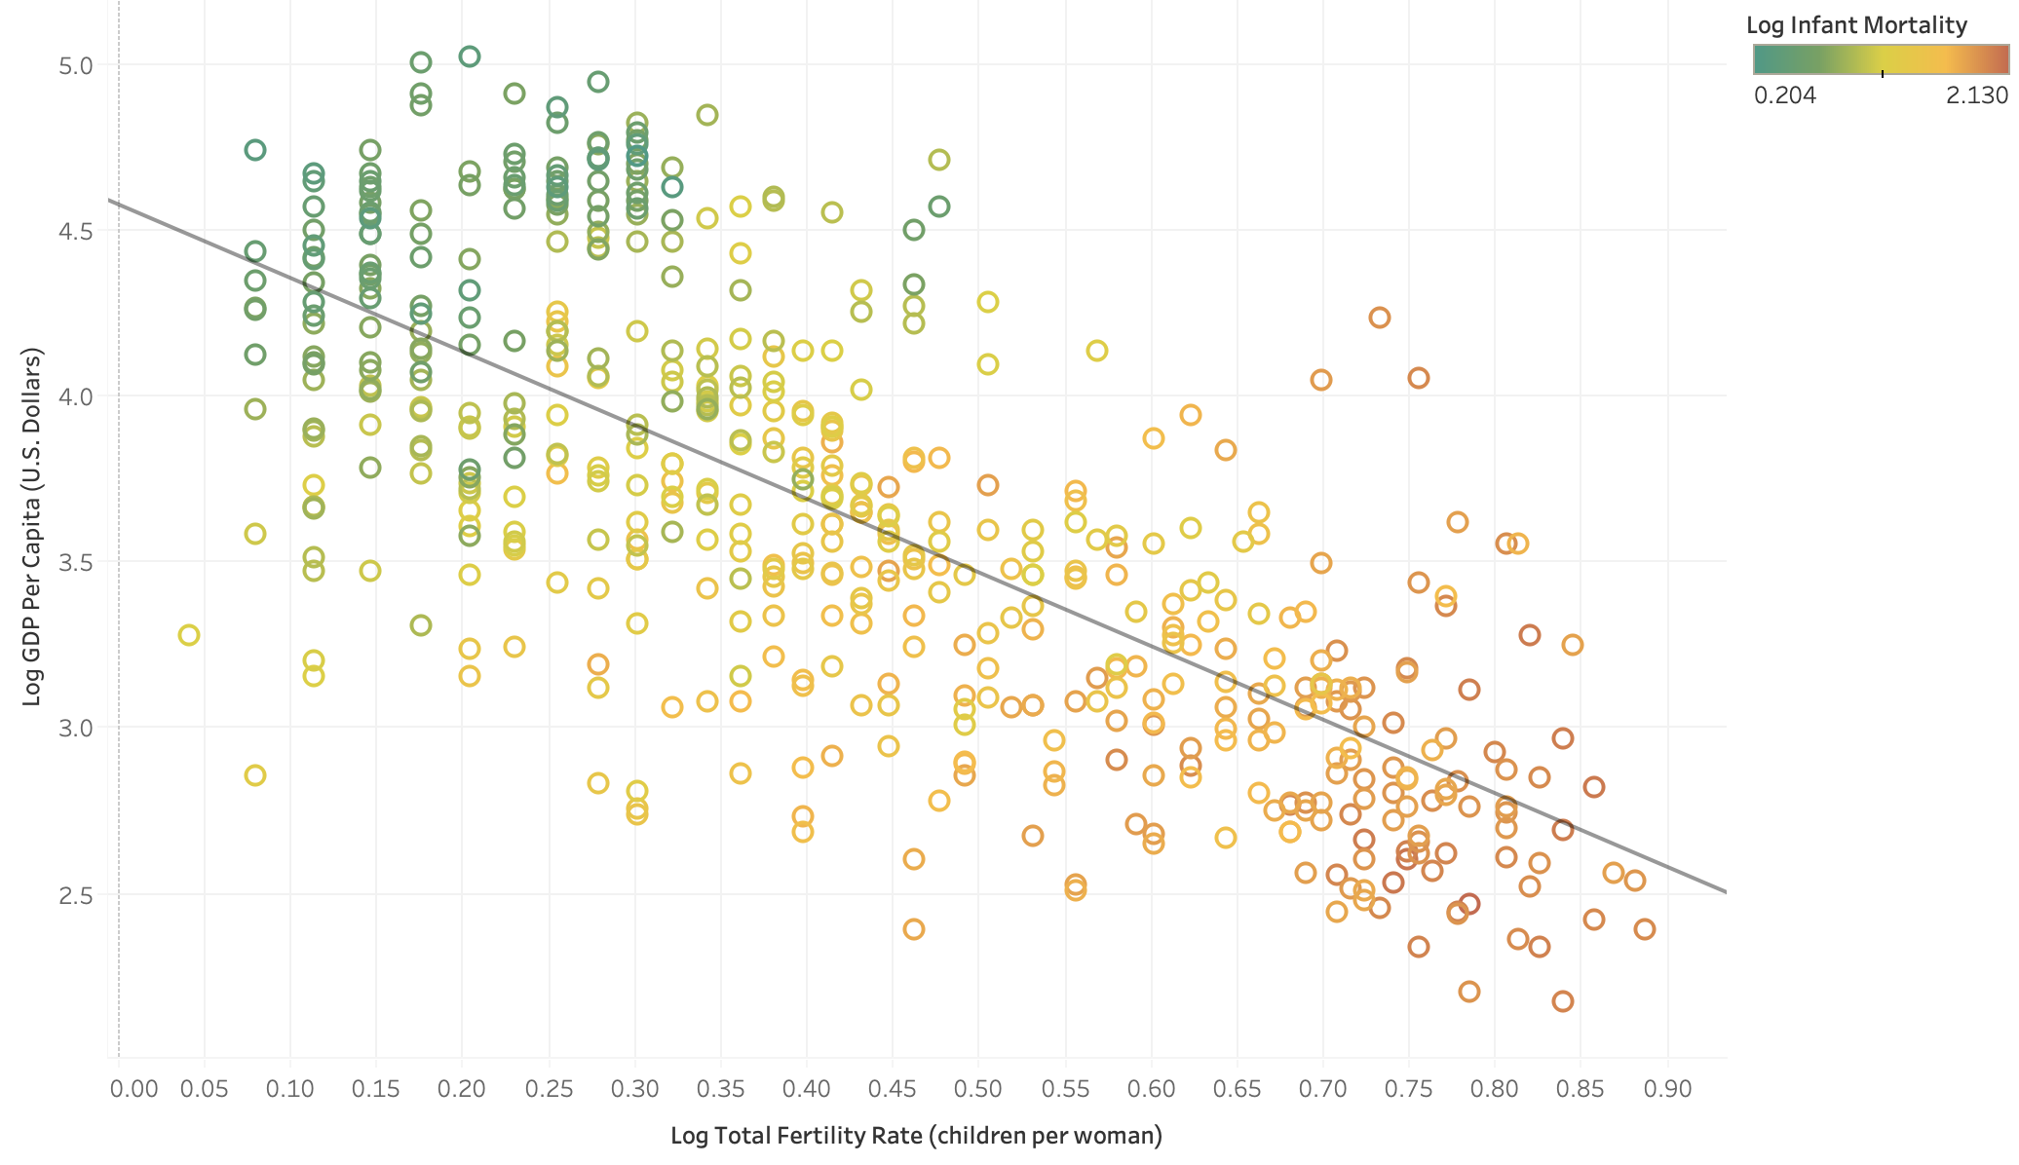
Confounding Variables

Slide 11
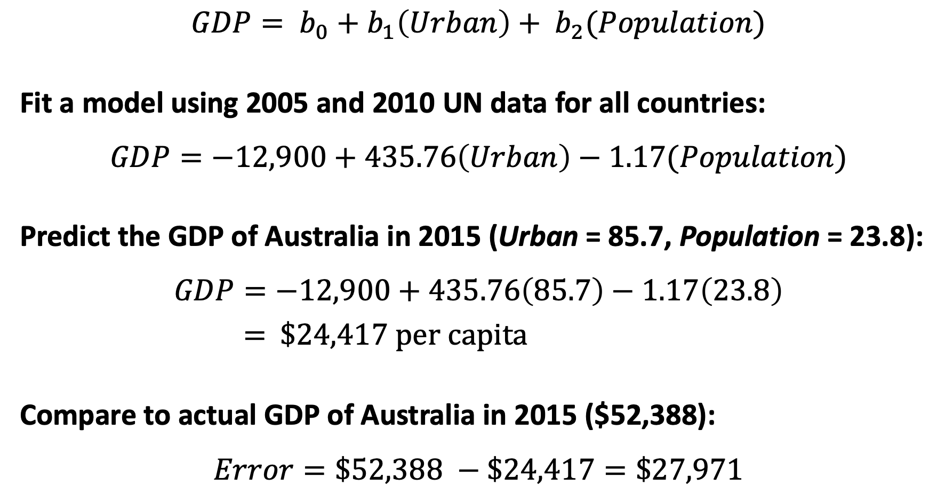
Multiple Linear Regression
$$GDP= b_{0}+b_{1}\left(Urban\right)+ b_{2}(Population)$$
Fit a model using 2005 and 2010 UN data for all countries:
$$GDP=−12,900+435.76\left(Urban\right)−1.17(Population)$$
Predict the GDP of Australia in 2015 (Urban = 85.7, Population = 23.8):
$$GDP=−12,900+435.76\left(85.7\right)−1.17\left(23.8\right)$$
= $24,417 per capita
Compare to actual GDP of Australia in 2015 ($52,388):
$$Error=\$52,388 −\$24,417=\$27,971$$

Slide 12
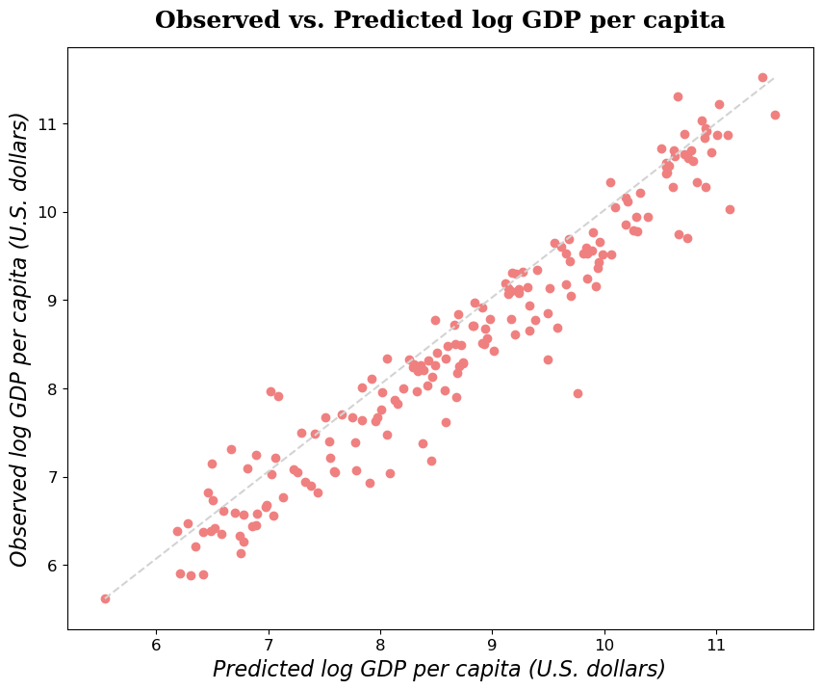
Predicted ~90% of Variance in 2015 Data
Best Predictive Model had R² value of 0.905 on test data (0.953 on training data)
Typical deviation of ~$1.50 U.S.
Accurately reproduced GDP
Best model kept 14 predictors and determined 13 were not significant
Libya
($6.14 residual)

Slide 13
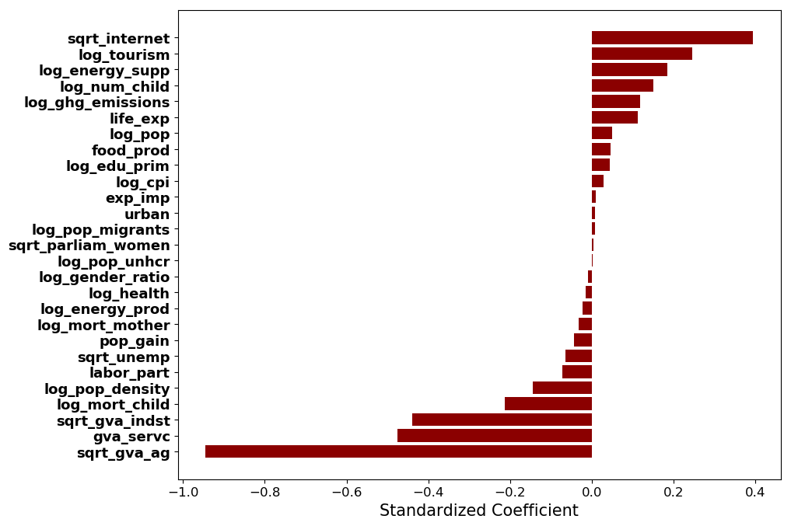
Strongest predictors include social metrics

Slide 14
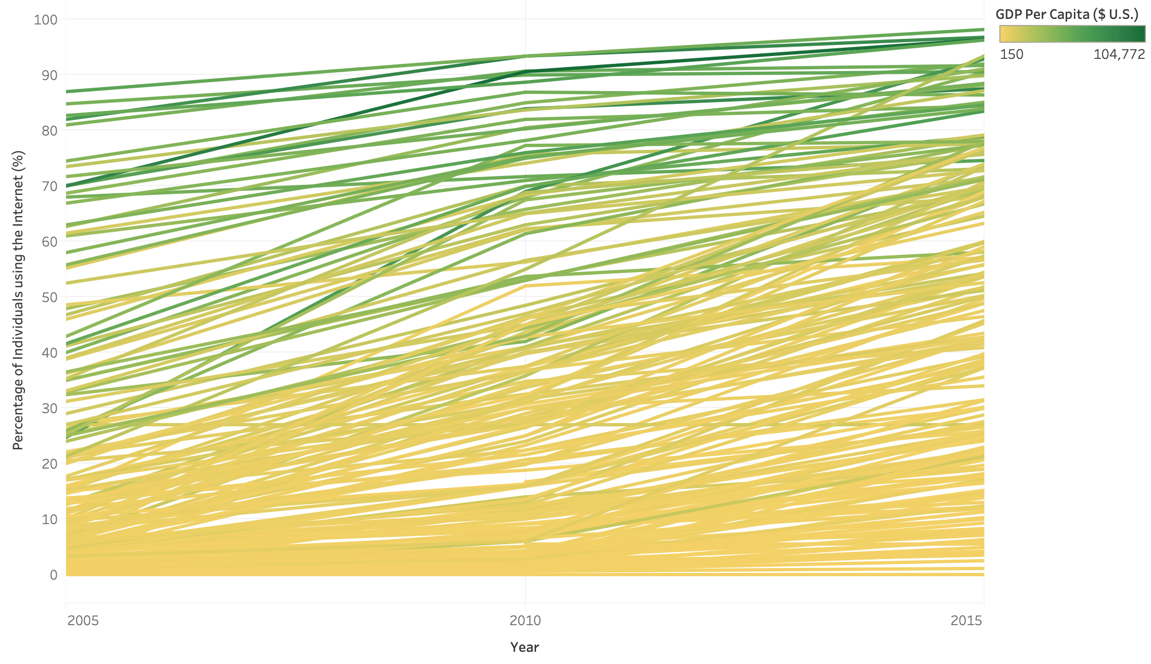

Slide 15
Which Features Were Significant?
Not Predictive | Positively Related | Negatively Related
Exports - Imports Difference | Percentage of Population using Internet | Gross Value Added by Agriculture
Year-to-Year Population Gain | Tourism Expenditure | Infant Mortality Ratio
Total Population | Energy Consumed per Capita | Maternal Mortality Ratio
Gender Ratio | GHG Emissions per Capita | Population Density
Energy Produced per Capita | Life Expectancy | Labor Force Participation Rate
Percentage of GDP Spent on Health | Percentage of Population Being Migrants | Unemployment Rate

Slide 16
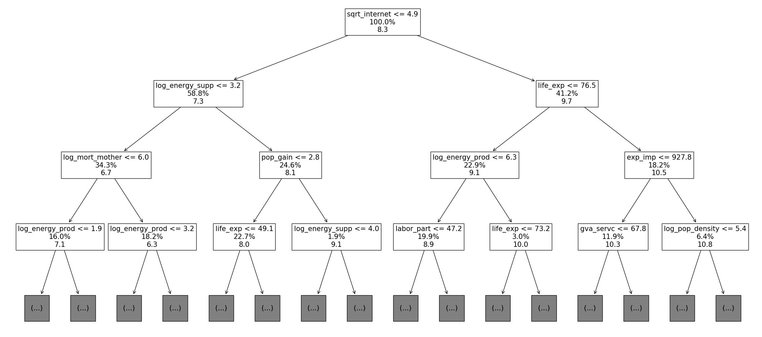
Random Forest for Improved Accuracy

Slide 17
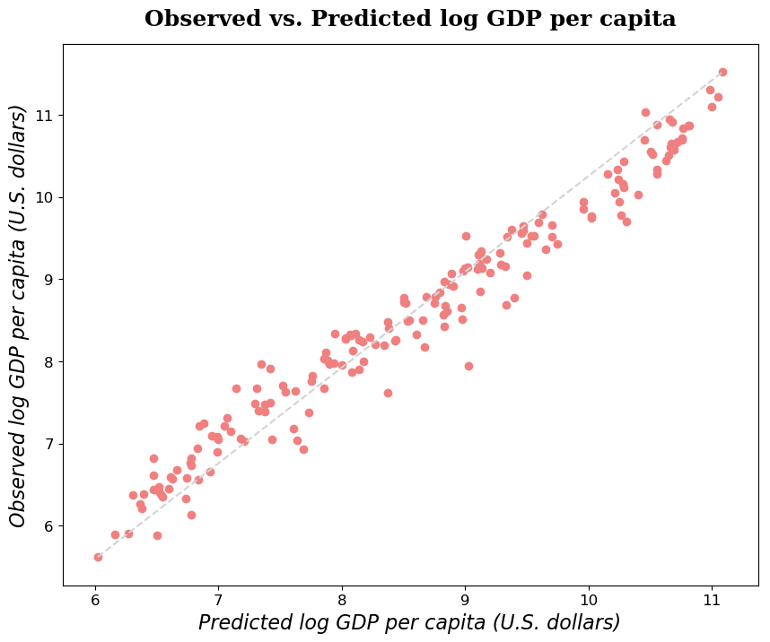
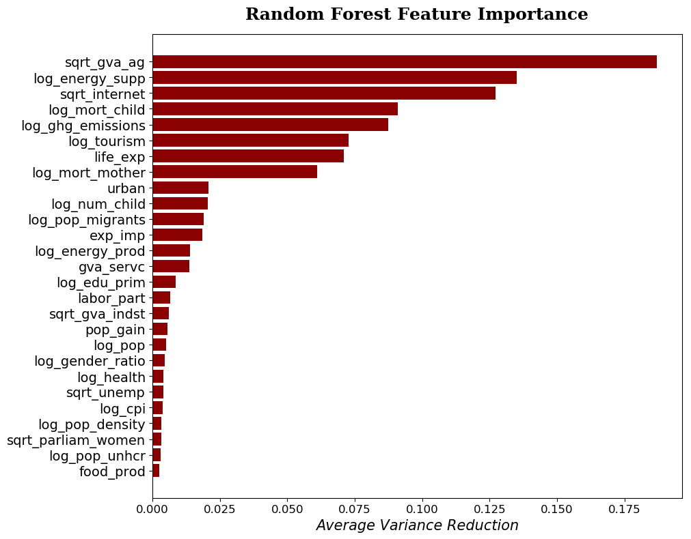
Random Forest Predictions and Features
Train R²: 100%
Test R²: 96.5%
RMSE: 1.30 U.S. Dollars

Slide 18

Key Insights
Countries with higher GDP per capita characterized by better access to healthcare and technology, larger energy consumption/GHG emissions, service-driven economies, and diverse urban populations
Social metrics such as education, gender distribution, and population growth largely non-predictive, but family size surprisingly relevant

Slide 19
Thank you

Slide 20
Appendix

Slide 21
Multiple Linear Regression
Allows us to model a quantitative feature (e.g. GDP) using a linear combination of predictor variables (e.g. GHG emissions, population, etc.)
Estimates a coefficient for each predictor that serves as a “weight” for how important that variable is
Considers the predictor variables as a group in determining the impact of each one individually
Highly flexible, interpretable, and fast

Slide 22
Random Forest
Ensemble method that combines the outputs of many decision trees for regression
Decision trees make a series of binary splits (on one feature at a time) to reduce the variance in the data as efficiently as possible
The bottom nodes of each tree assign predictions to new samples by simply averaging the response values (GDP) of the training samples in that node
Random forests randomize the samples and features used to build each tree in order to avoid overfitting the training data

Slide 23
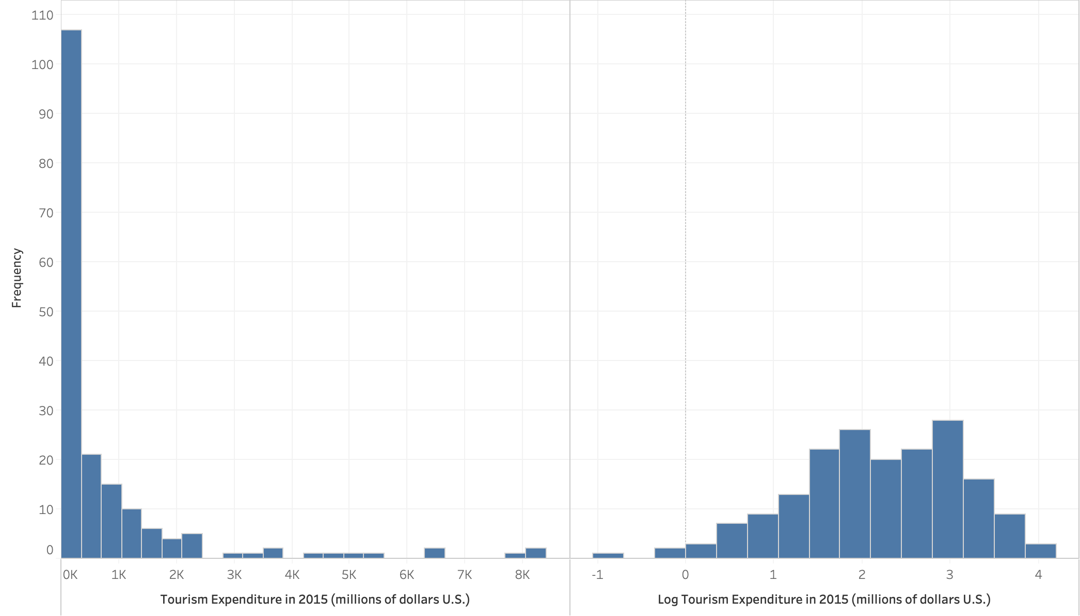
Feature Transformations
Before
After

Slide 24
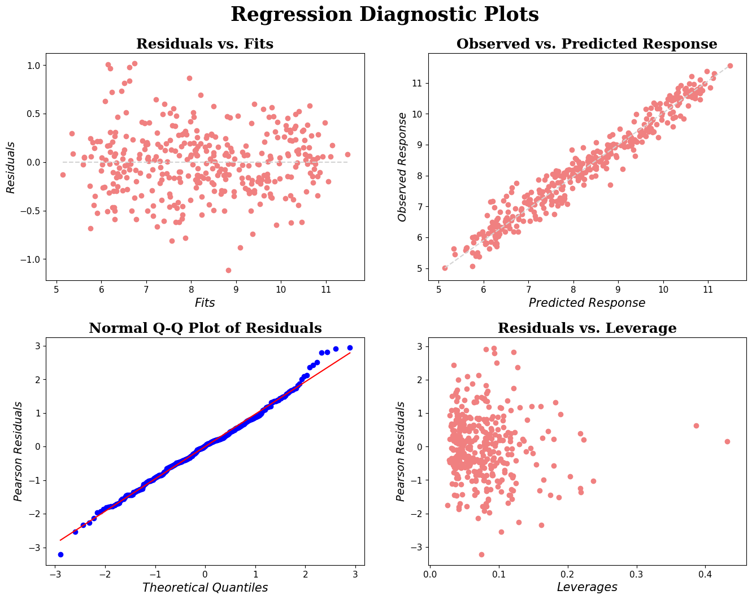
Regression Errors

Slide 25
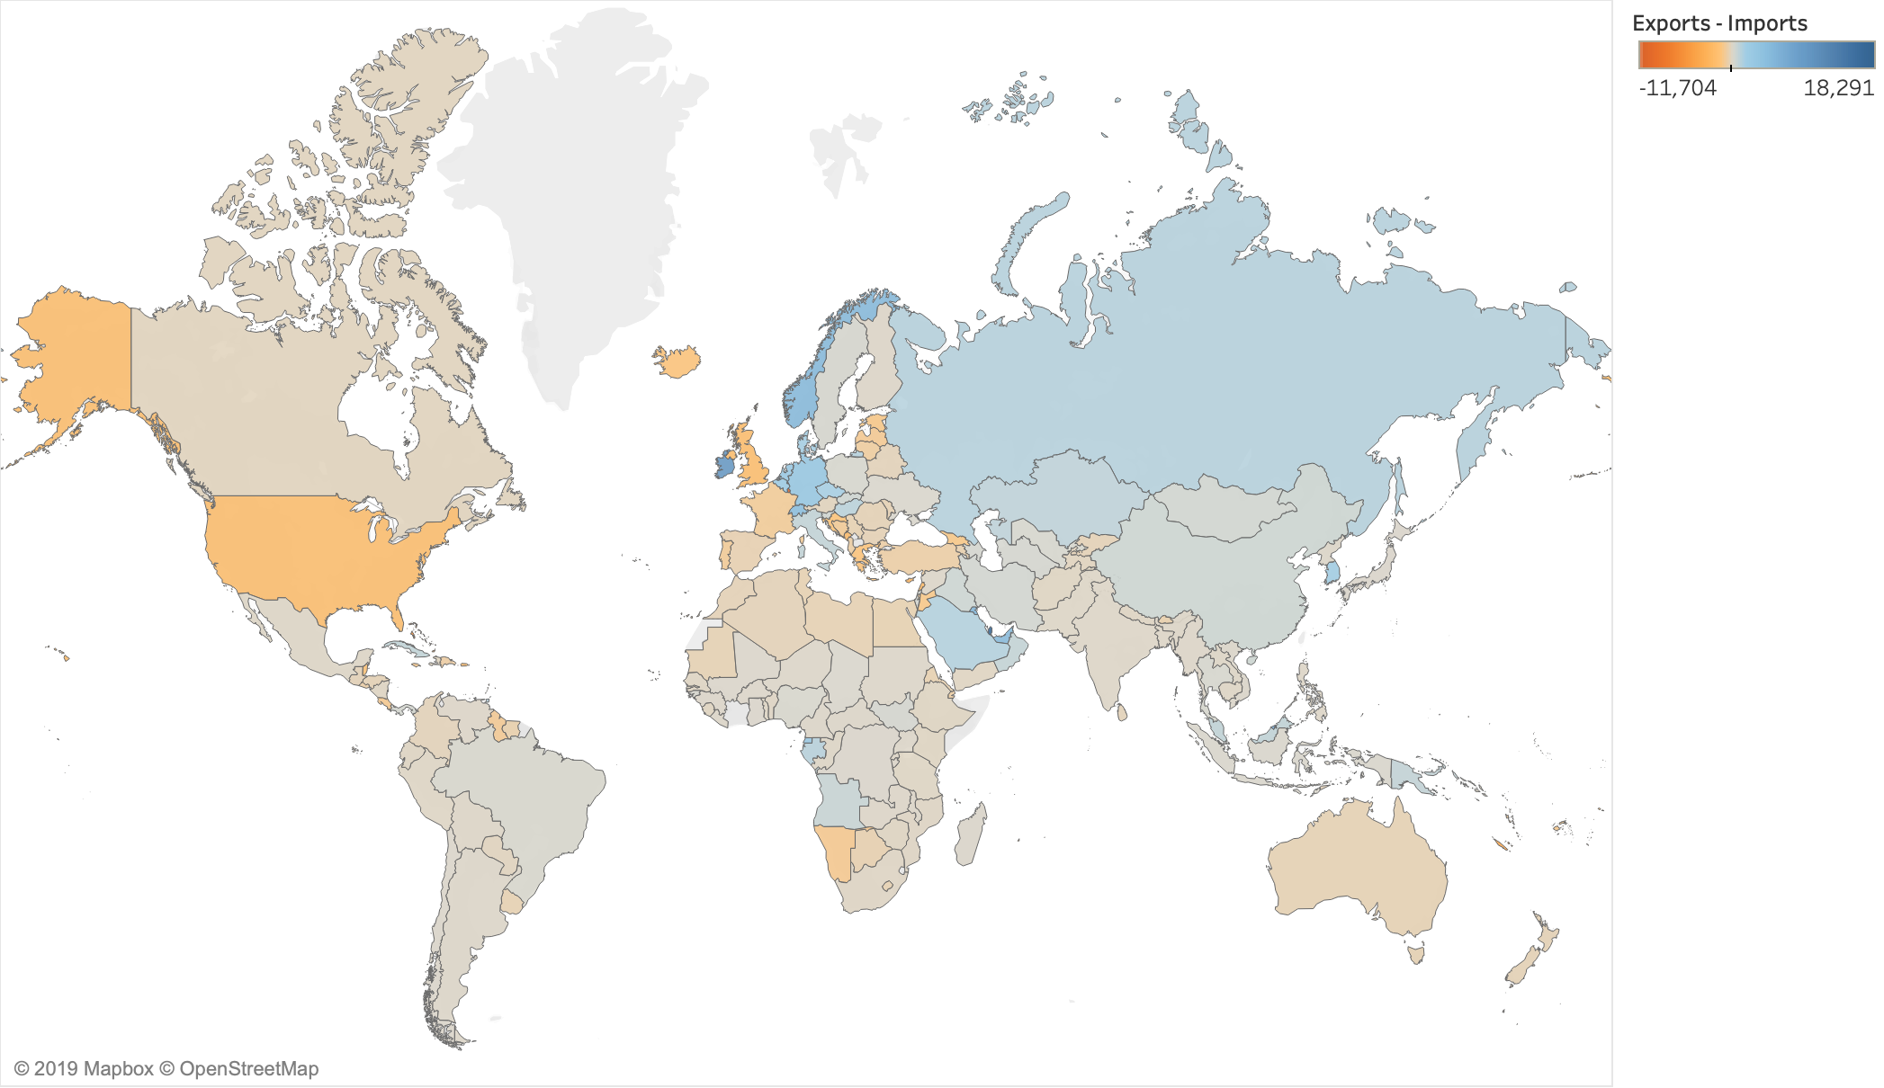

Slide 26
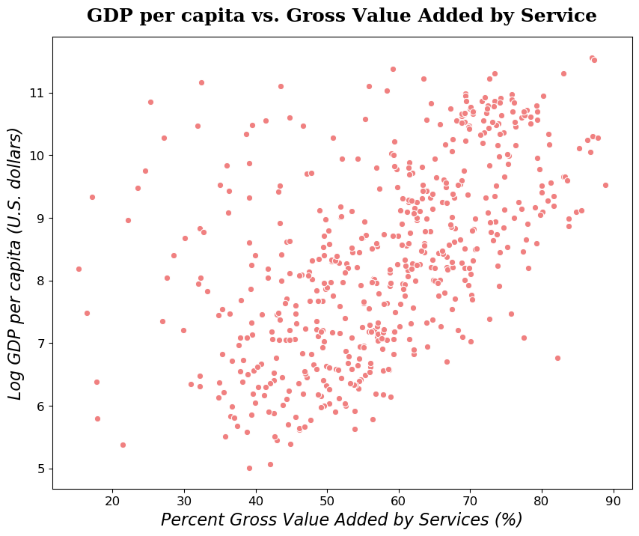
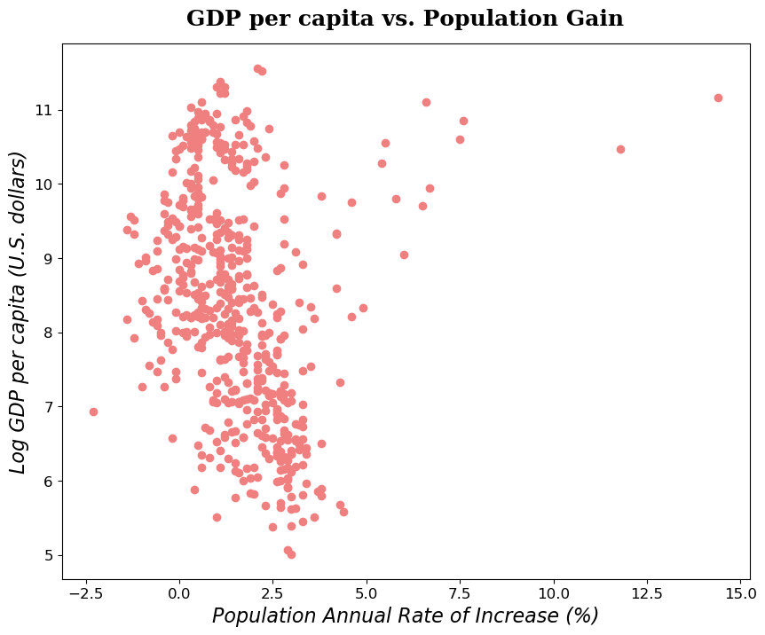
Qatar
United Arab Emirates

